Slide 1
Prokaryotic cell

Slide 2
Definition of prokaryote
Any of the typically unicellular microorganisms that lack a distinct nucleus and membrane-bound organelles and that are classified as a kingdom (Prokaryotae synonym Monera) or into two domains (Bacteria and Archaea).
What are examples of prokaryotic?----Prokaryotic cells lack internal cellular bodies (organelles), while eukaryotic cells possess them. Examples of prokaryotes are bacteria and archaea. Examples of eukaryotes are protists, fungi, plants, and animals (everything except prokaryotes).

Slide 3
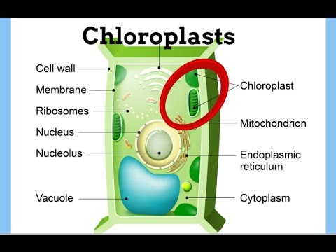
What are examples of prokaryotes?
Prokaryotes can be split into two domains, archaea and bacteria.
Cyanobacteria are sometimes considered algae, but they are actually bacteria (prokaryotic), where the term "algae" is now reserved for eukaryotic organisms. They also derive their energy through photosynthesis, but lack a nucleus or membrane bound organelles, like chloroplasts.

Slide 4
Components of a prokaryotic cell
All cells share four common components:
a plasma membrane: an outer covering that separates the cell’s interior from its surrounding environment.
cytoplasm: a jelly-like cytosol within the cell in which other cellular components are found
DNA: the genetic material of the cell
ribosomes: where protein synthesis occurs , they also
Some other components or parts like pilli ,flagella ,fimbriae, capsule, cell wall, mesosome, chromatophore.

Slide 5
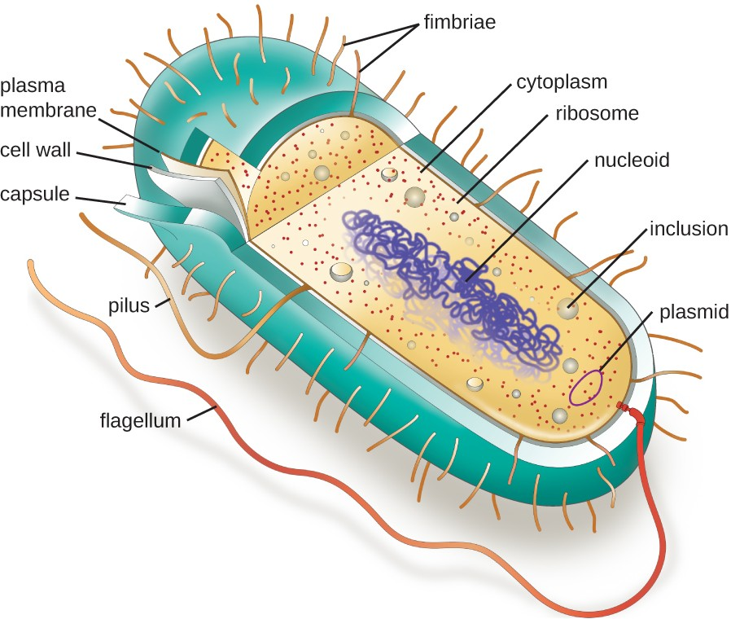
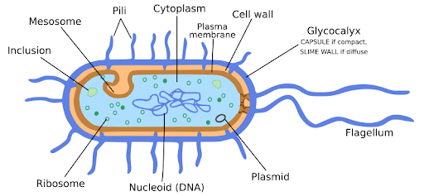
STRUCTURE:

Slide 6
What are the fundamental components of a prokaryotic cell?
The Nucleoid----The nucleoid (meaning nucleus-like) is an irregularly shaped region within the prokaryotic cell that contains all or most of the genetic material.[While most prokaryotes, like E. coli, contain a single circular DNA molecule that makes up their entire genome]
In contrast to the nucleus of a eukaryotic cell, it is not surrounded by a nuclear membrane.
Prokaryotic DNA and DNA-associated proteins are concentrated within the nucleoid region of the cell .
In general, prokaryotic DNA interacts with nucleoid-associated proteins (NAPs) that assist in the organization and packaging of the chromosome.
NAPs function similar to histones, which are the DNA-organizing proteins found in eukaryotic cells.

Slide 7
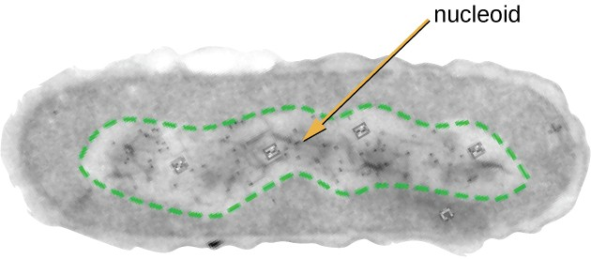
The nucleoid region (the area enclosed by the green dashed line) is a condensed area of DNA found within prokaryotic cells. Because of the density of the area, it does not readily stain and appears lighter in color when viewed with a transmission electron microscope.
While most prokaryotes, like E. coli, contain a single circular DNA molecule that makes up their entire genome

Slide 8
Plasmids:
Prokaryotic cells may also contain extrachromosomal DNA, or DNA that is not part of the chromosome.
This extrachromosomal DNA is found in plasmids, which are small, circular, double-stranded DNA molecules.
Plasmids are more commonly found in bacteria; however, plasmids have been found in archaea and eukaryotic organisms.
Plasmids often carry genes that confer advantageous traits such as antibiotic resistance; thus, they are important to the survival of the organism.
Cells that have plasmids often have hundreds of them within a single cell.

Slide 9
Ribosomes
Prokaryotic ribosomes are found in the cytoplasm.
They are called 70S ribosomes because they have a size of 70S, whereas eukaryotic cytoplasmic ribosomes have a size of 80S. (The S stands for Svedberg unit, a measure of sedimentation in an ultracentrifuge, which is based on size, shape, and surface qualities of the structure being analyzed).
However, ribosomes in each of the three domains are structurally different.
All cellular life synthesizes proteins, and organisms in all three domains of life possess ribosomes, structures responsible for protein synthesis.

Slide 10
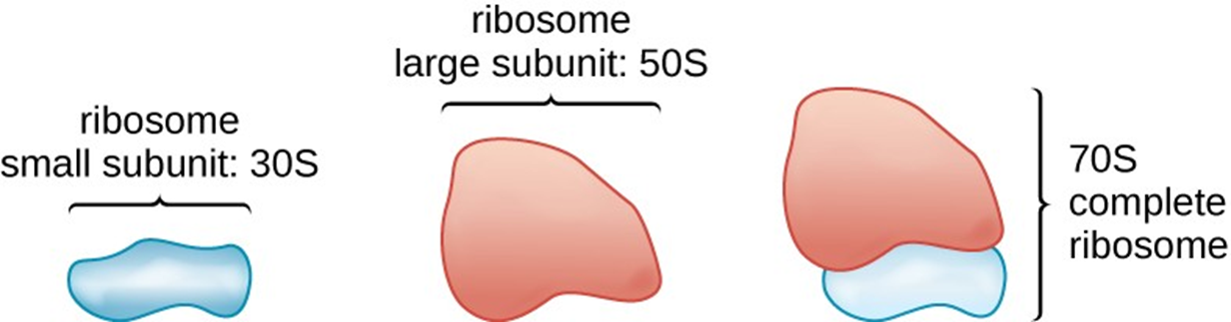
Prokaryotic ribosomes (70S) are composed of two subunits: the 30S (small subunit) and the 50S (large subunit), each of which are composed of protein and rRNA components.

Slide 11
Endospores
Bacterial cells are generally observed as vegetative cells, but some genera of bacteria have the ability to form endospores, structures that essentially protect the bacterial genome in a dormant state when environmental conditions are unfavorable.
Vegetative Cells | Endospores
Sensitive to extreme temperatures and radiation | Resistant to extreme temperatures and radiation
Gram-positive | Do not absorb Gram stain, only special endospore stains
Normal water content and enzymatic activity | Dehydrated; no metabolic activity
Capable of active growth and metabolism | Dormant; no growth or metabolic activity

Slide 12
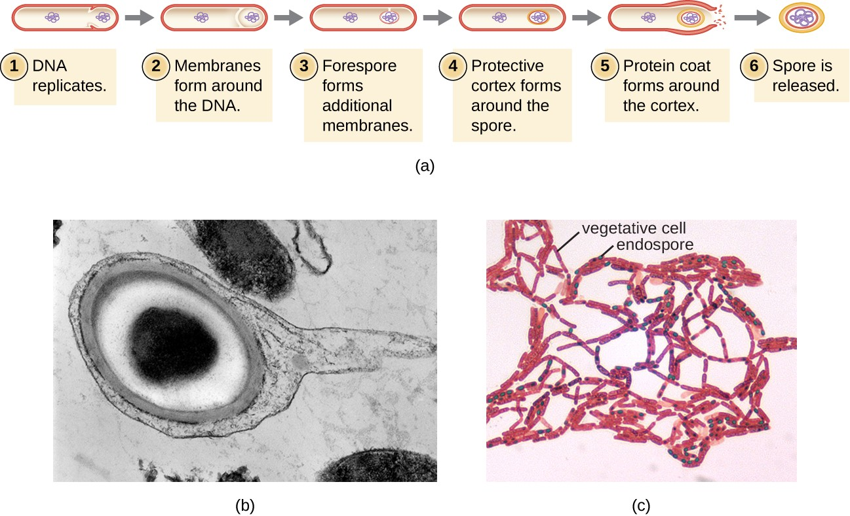
The process by which vegetative cells transform into endospores is called sporulation, and it generally begins when nutrients become depleted or environmental conditions become otherwise unfavorable
Sporulation begins following asymmetric cell division. The forespore becomes surrounded by a double layer of membrane, a cortex, and a protein spore coat, before being released as a mature endospore upon disintegration of the mother cell

Slide 13
Plasma Membrane
Structures that enclose the cytoplasm and internal structures of the cell are known collectively as the cell envelope.
All cells (prokaryotic and eukaryotic) have a plasma membrane (also called cytoplasmic membrane or cell membrane) that exhibits selective permeability, allowing some molecules to enter or leave the cell while restricting the passage of others.
The structure of the plasma membrane is often described in terms of the fluid mosaic model.
The plasma membrane structure of most bacterial and eukaryotic cell types is a bilayer composed mainly of phospholipids formed with ester linkages and proteins.

Slide 14
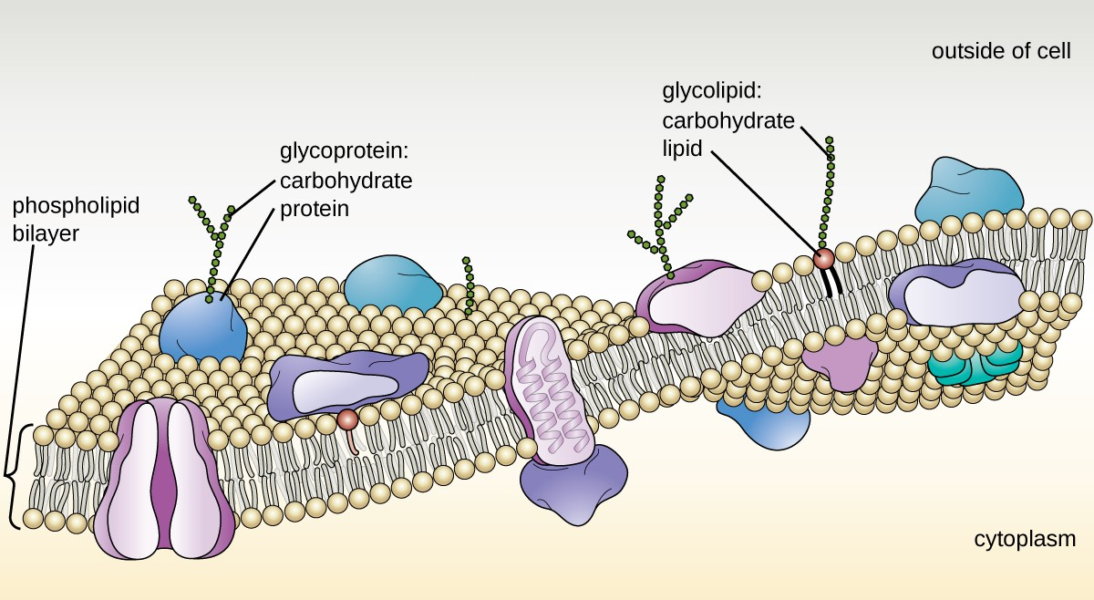
These phospholipids and proteins have the ability to move laterally within the plane of the membranes as well as between the two phospholipid layers.
[figure]The bacterial plasma membrane is a phospholipid bilayer with a variety of embedded proteins that perform various functions for the cell. Note the presence of glycoproteins and glycolipids, whose carbohydrate components extend out from the surface of the cell. The abundance and arrangement of these proteins and lipids can vary greatly between species.

Slide 15
These glycoprotein and glycolipid complexes extend out from the surface of the cell, allowing the cell to interact with the external environment.
Glycoproteins and glycolipids in the plasma membrane can vary considerably in chemical composition among archaea, bacteria, and eukaryotes, allowing scientists to use them to characterize unique species.
Plasma membranes from different cells types also contain unique phospholipids, which contain fatty acids. Phospholipid-derived fatty acid analysis (PLFA) profiles can be used to identify unique types of cells based on differences in fatty acids. Archaea, bacteria, and eukaryotes each have a unique PFLA profile.

Slide 16
Photosynthetic Membrane Structures [cell membrane modification]
Some prokaryotic cells, namely cyanobacteria and photosynthetic bacteria, have membrane structures that enable them to perform photosynthesis.
These structures consist of an infolding of the plasma membrane that encloses photosynthetic pigments such as green chlorophylls and bacteriochlorophylls.
In cyanobacteria, these membrane structures are called thylakoids; in photosynthetic bacteria, they are called chromatophores, lamellae, or chlorosomes.

Slide 17
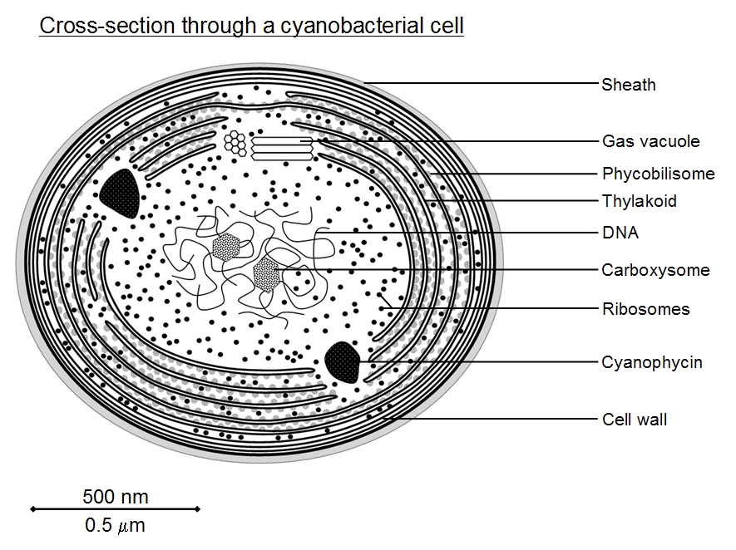
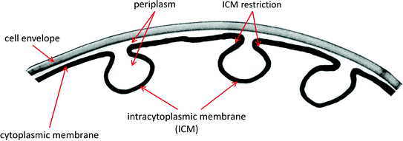
Infolding contains pigments

Slide 18
MESOSOMES [CELL MEMBRANE MODIFICATION]
Mesosomes or chondrioids are folded invaginations in the plasma membrane of bacteria.
A specialized membraneous structure is a mesosome which is formed by an extension of plasma membrane into the cell. These extensions are in the form of vesicle, tubules, and lamellae.
FUNCTIONS:(1) These extensions help in the synthesis of the cell wall and replication of DNA. They also help in the equal distribution of chromosomes into the daughter cells.
(2) It also increases the surface area of the plasma membrane to carry out various enzymatic activities.
(3) It helps in secretion processes as well as in bacterial respiration.

Slide 19
TYPES OF MESOSOMES:
1]septal or central mesosome.
Help in DNA replication and transfer of replicated DNA to daughter cell.
Help in formation of septa / Cross wall during binary fission.
2]peripheral or lateral mesosome
Also called chondroid.
Analogous to mitochondria of eukaryotic cell.
Site for respiration bacteria.
Has enzyme for electron transport chain[ETC]
Provide large surface area for enzyme activity.

Slide 20
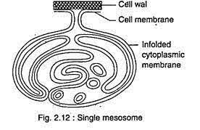
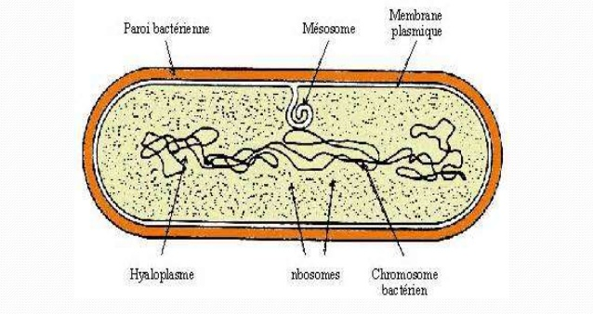
Structure of mesosomes:
lamella
vesicle
Forms of mesosomes:vesicles,tubules,lamella
tubules

Slide 21
Cell Wall
The primary function of the cell wall is to protect the cell from harsh conditions in the outside environment.
When present, there are notable similarities and differences among the cell walls of archaea, bacteria, and eukaryotes.
The major component of bacterial cell walls is called peptidoglycan (or murein); it is only found in bacteria.
Archaeal cell wall structure differs from that of bacteria in several significant ways.
archaeal cell walls do not contain peptidoglycan; instead, they contain a similar polymer called pseudopeptidoglycan (pseudomurein)

Slide 22
Last, as is the case with some bacterial species, there are a few archaea that appear to lack cell walls entirely.
Like , Mycoplasma.

Slide 23
Glycocalyces and S-Layers:
Although most prokaryotic cells have cell walls, some may have additional cell envelope structures exterior to the cell wall, such as glycocalyces and S-layers.
glycocalyx is a sugar coat, of which there are two important types: capsules and slime layers.
A capsule is a well organized layer located outside of the cell wall and usually composed of polysaccharides or proteins.
A slime layer is a less tightly organized layer that is only loosely attached to the cell wall and can be more easily washed off. Slime layers may be composed of polysaccharides, glycoproteins, or glycolipids.

Slide 24
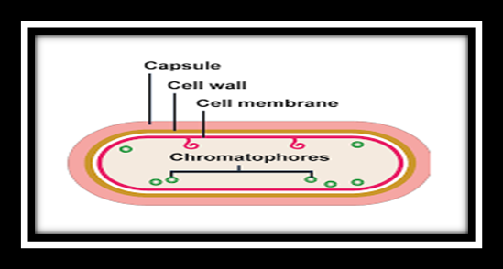
Also protect cells from predation and hinder the action of antibiotics and disinfectants.

Slide 25
S-layer is another type of cell envelope structure; it is composed of a mixture of structural proteins and glycoproteins. In bacteria, S-layers are found outside the cell wall, but in some archaea, the S-layer serves as the cell wall.
The exact function of S-layers is not entirely understood, and they are difficult to study; but available evidence suggests that they may play a variety of functions in different prokaryotic cells, such as helping the cell withstand osmotic pressure and, for certain pathogens, interacting with the host immune system.
The ability to produce a capsule can contribute to a microbe’s pathogenicity (ability to cause disease) because the capsule can make it more difficult for phagocytic cells (such as white blood cells) to engulf and kill the microorganism. Streptococcus pneumoniae, for example, produces a capsule that is well known to aid in this bacterium’s pathogenicity.

Slide 26
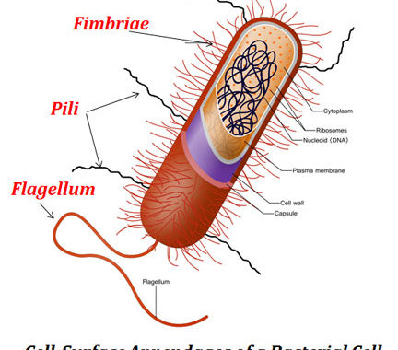
Filamentous Appendages
Many bacterial cells have protein appendages embedded within their cell envelopes that extend outward, allowing interaction with the environment. These appendages can attach to other surfaces, transfer DNA, or provide movement. Filamentous appendages include fimbriae, pili, and flagella.

Slide 27
FLAGELLA:
Introduction of Flagella---
Flagella are the complex filamentous cytoplasmic structure protruding through cell wall. These are unbranched, long, thread like structures, mostly composed of the protein flagellin, intricately embedded in the cell envelope.
They are about 12-30 nm in diameter and 5-16 µm in length.
They are responsible for the bacterial motility. Motility plays an important role in survival and the ability of certain bacteria to cause disease.

Slide 28
Types and Examples of Flagella
1. Monotrichous:
presence of single flagella in one end of cell.
examples; Vibrio cholera, Pseudomonas aerogenosa
2. Lophotrichous:
presence of bundle of flagella in one end of cell.
example: Pseudomonas fluroscence
3. Amphitrichous:
presence of single or cluster of flagella at both end of cell.
example; Aquaspirillium

Slide 29
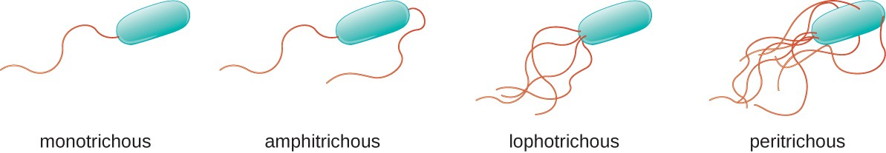
4. Peritrichous
– Numerous falgella all over the bacterial body
– Example: Salmonella Typhi
5. Atrichous:
absent of flagella.
example; Shigella

Slide 30
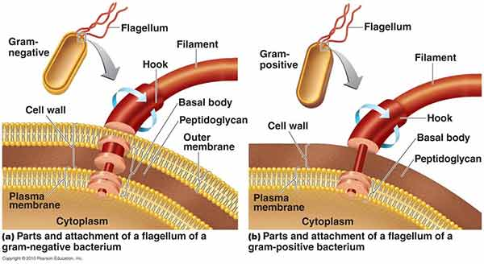
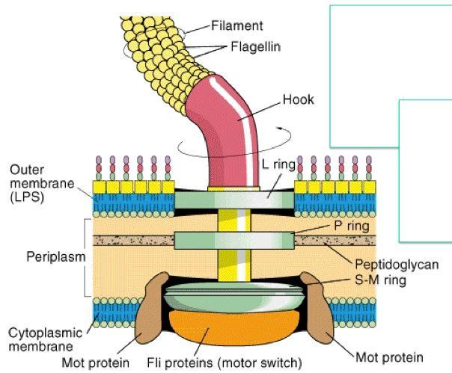
Diagram:

Slide 31
Parts of flagella:
Flagella is not straight but is helical.
It is composed of flagellin protein (globular protein) and known as H antigen.
Flagella has three parts. Basal body, Hook and filament
Filament:
it is thin hair like structure arises from hook.
Hook:
it is the wider region at the base of filament
it connects filament to the motor protein in the base
length of hook is longer in gram +ve bacteria than gram –ve bacteria

Slide 32
Basal body:
it is composed of central rod inserted into series of rings which is attached to cytoplasmic memvbrane and cell wall.
L-ring: it is the outer ring present only in Gram -ve bacteria, it anchored in lipopolysaccharide layer
P-ring: it is second ring anchored in peptidoglycan layer of cell wall.
M-S ring: anchored in cytoplasmic membrane
C ring: anchored in cytoplasm
*NOTE---A wet mount technique for staining bacterial flagella is simple and is useful when the number and arrangement of flagella are critical in identifying species of motile bacteria.

Slide 33
Flagellar motility:
At the base surrounding the inner ring (M-S and C ring) there is a series of protein called Mot protein.
A final set of protein called Fli protein function as motor switch. The flagella motor rotates the filament as a turbine causing movement of the cell in the medium.
The movement of flagella results from rotation of basal body which is similar to the movement of the shaft of an electric motor.
A turning motion is generated between S-ring and M ring. S-ring acts as starter while M ring acts as roter.
The basal body as a whole give a universal joint to the cell and allows complete rotation of hook and filament.
Flagella moves the cell by rotating the flagella about the basal body. Rotation of flagella is either clockwise or anticlockwise.

Slide 34
Functions of Flagella
Movements
Sensation
Signal transduction
Adhesion
For cells anchored in a tissue, like the epithelial cells lining our air passages, this moves liquid over the surface of the cell (e.g., driving particle-laden mucus toward the throat).
Flagella are generally accepted as being important virulence factors

Slide 35
Fimbriae [short attachment pili]
In bacteriology, a fimbria (Latin for 'fringe', plural fimbriae), also referred to as an "attachment pilus" by some scientists, is a type of appendage that is found on many Gram-negative and some Gram-positive bacteria, and that is thinner and shorter than a flagellum
Fimbriae are used by bacteria to adhere to one another and to adhere to animal cells and some inanimate objects. A bacterium can have as many as 1,000 fimbriae. Fimbriae are only visible with the use of an electron microscope. They may be straight or flexible.
Made up of fimbrillin protein.
Comparatively shorter in length than pili and flagella.
No role in bacterial motility and conjugation.

Slide 36
Pili:
Pilin refers to a class of fibrous proteins that are found in pilus structures in bacteria.
Bacterial pili are used in the exchange of genetic material during bacterial conjugation, while a shorter type of appendages also made up of pilin, called fimbriae, are used as a cell adhesion mechanism. Although not all bacteria have pili or fimbriae.
Pili are typically longer and fewer in number than fimbriae. They are found in virtually all Gram-negative bacteria but not in many Gram-positive bacteria.
The fimbriae and pili have a shaft composed of a protein called pilin.

Slide 37
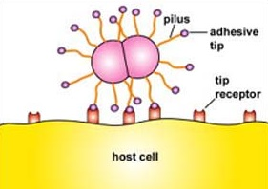
At the end of the shaft is the adhesive tip structure having a shape corresponding to that of specific glycoprotein or glycolipid receptors on a host cell .
There are two basic types of pili: short attachment pili and long conjugation pili.
Adhesive Tip of Bacterial Pili Binding to Host Cell Receptors

Slide 38
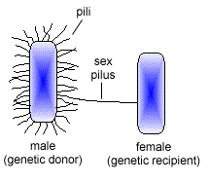
Long conjugation pili, also called "F" or sex pili that are longer and very few in number AND Common pili [short attachment pili also called fimbriae
The conjugation pilus enables conjugation. conjugation is the transfer of DNA from one bacterium to another by cell-to-cell contact.
In gram-negative bacteria it is typically the transfer of DNA from a donor or "male bacterium" with a sex pilus to a recipient or "female bacterium" to enable genetic recombination.
Conjugation (Sex) Pilus

Slide 39
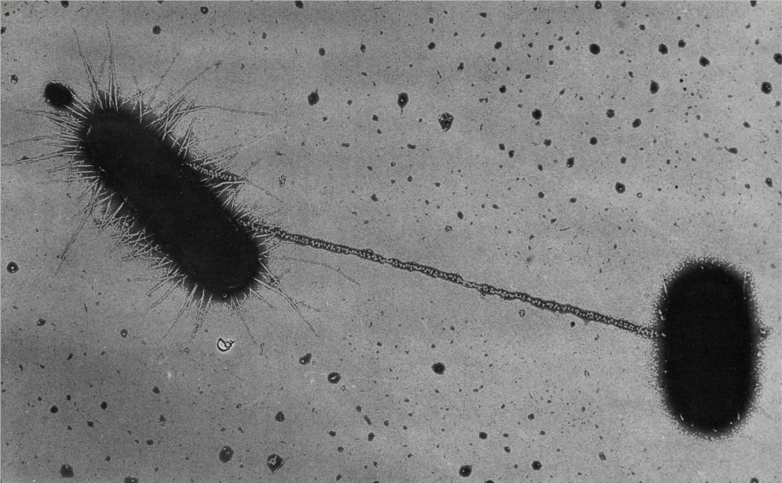
Scanning electron micrograph of E.coli bacteria exchanging genes.

Slide 40

.

